Slide 1
Chapter. 9 Phases of matters
Determine the intermolecular spacing/size/ separation btwn molecules d
LimWH April 2012

Slide 2
Assuming a simple model, 8 atoms located at the corner of a cube of edge d.
d

Slide 3
Since each atom at the corner is shared by another 7 cubes (except those along the edges), the occupation of a cube over one atom is just 1/8.

Slide 4
Hence, the effective number of atoms possessed by one cube is only 1/8 of one atom multiplied by 8 atoms = 1 atom.
≡
d

Slide 5
d
mass of one cube
= mass of one atom or molecule
volume of one cube
= d³

Slide 6
Density = mass/volume
Density = mass of one cube / volume of one cube
Density = mass of one atom / d³
and mass of one atom = molar mass/ N_{A}
Molar mass is the nucleon number which tells us the amount of grams per mol of a substance

Slide 7
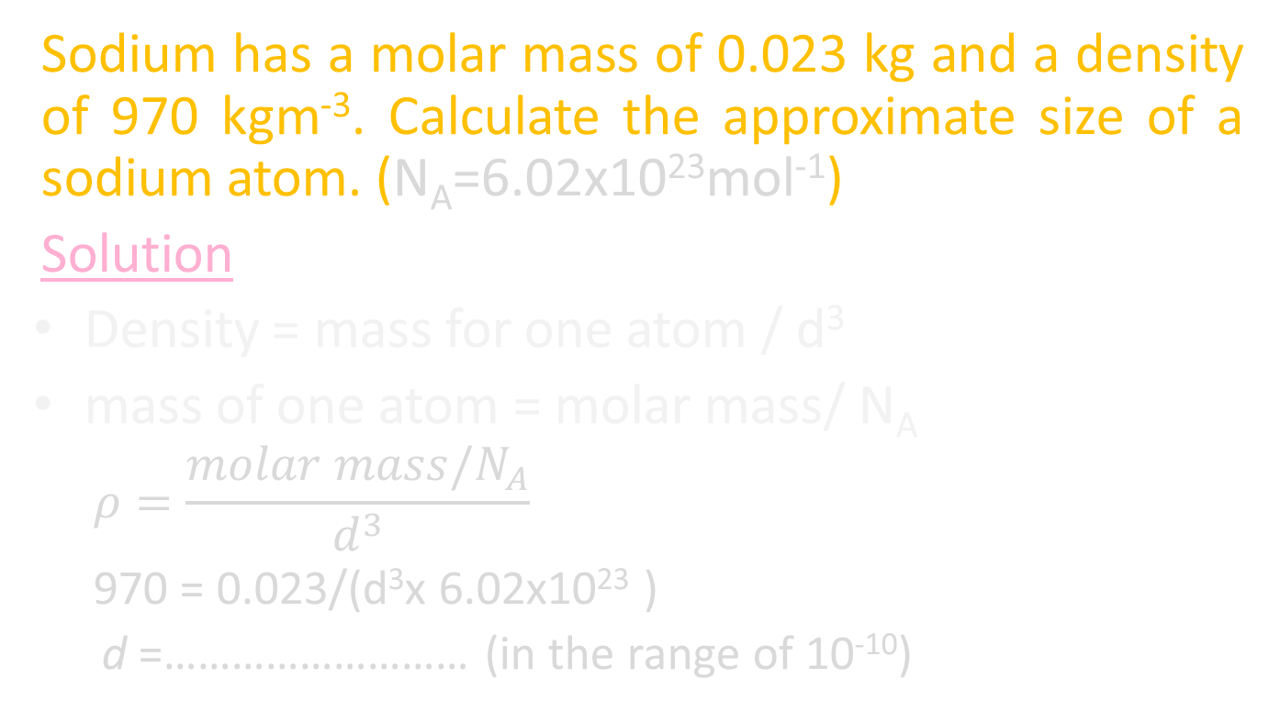
question
Sodium has a molar mass of 0.023 kg and a density of 970 kgm⁻³. Calculate the approximate size of a sodium atom. (N_{A}=6.02x10²³mol⁻¹)
Solution
Density = mass for one atom / d³
mass of one atom = molar mass/ N_{A}
$$ρ=\frac{molar mass/N_{A}}{d^{3}}$$
970 = 0.023/(d³x 6.02x10²³ )
d =……………………… (in the range of 10⁻¹⁰)

Slide 8
Extra questions :
The molar mass of magnesium is 0.024 kg and has a density of 1740 kgm⁻³
Calculate the approximate size of a magnesium atom.
Density of steam and water are given as rs and rw, respectively. M kg of water turns into steam at the boiling point. Determine the ratio of the separation of molecules in water to that in steam, in terms of rs and rw.

Slide 9
THE END…

